Slide 1


Binaryxx Sune
01/27/2023

Slide 2

Outline
Executive Summary
Introduction
Methodology
Results
Conclusion
Appendix

Slide 3

Executive Summary
Payload Mass, Orbit Type, and Booster Versions were key elements in determining on whether the first stage rocket would land successfully
Another aspect to consider is that the more recent (such as future launches) will tend to have a higher success rate compared to launches with similar conditions during the first few launches by SpaceX
The 3 models selected for predicting landing success rate, LogReg, SVM, and KNN, are able to determine whether launches would result in successful landing but with a slight problem with False Positives (predicting a successful landing when it will not). Regardless, all three models sport a 90% plus accuracy for out of sample data

Slide 4
Introduction
SpaceX is able to conduct rocket launches at competitively low prices due to the fact that they are sometimes able to reuse the first stage rocket. The first stage rocket is the main rocket which sends the fairing and second stage rocket into orbit. The fairing contains the payload, and the second stage rocket helps guide the fairing once in orbit. The first stage of the rocket is significantly larger than the other two components, which results in bearing most of the costs due to the resources it requires.
By determining the probability of a successful salvage of the first stage rocket, the costs can be calculated for a given launch. A successful salvage results in cost savings since the rocket can be reused for future launches rather than making a new first stage rocket.

Slide 5

Section 1

Slide 6
Methodology
Executive Summary
Data collection methodology:
Data was gathered primarily from the SpaceX REST API, which provides data about launches, such as landing outcome.
Data was also gathered by web scraping wiki pages relating to the launches
Perform data wrangling
Some data information from the API were IDs rather than the actual values, resulting in the use of the API again to relate those IDs to their respective values.
Only the relevant data needs to be kept, so proper filtering of the data set needs to be done so that the appropriate rocket boosters are selected (Falcon 9)
Null values for the rocket boosters are set to its mean value, while landing pad values were left null since that column was irrelevant
Perform exploratory data analysis (EDA) using visualization and SQL
Perform interactive visual analytics using Folium and Plotly Dash
Perform predictive analysis using classification models
Built models based on optimal hyperparameters with the help of GridSearchCV to select the parameters which provided the highest in sample accuracy.
Evaluation of these models are done through a confusion matrix and it’s out of sample prediction accuracy

Slide 7

Data Collection
Data was gathered primarily from the SpaceX REST API, which provides data about launches, such as landing outcome.
Data was also gathered by web scraping wiki pages relating to the launches with the help of BeautifulSoup library; information regarding the launches similar to the info provided by the API was collected through this method

Slide 8
Data Collection – SpaceX API
Using the SpaceX API, relevant data was collected. There were instances where the values retrieved for certain columns were ID references, not inherently containing information. This would then require a search of the appropriate endpoints to relate the IDs to the corresponding values.
Below is a link to the notebook to conduct this process:
GitHub URL SpaceX API
Relate the IDs Provided to Their Actual Values
Yes
Find the Endpoints with Info Needed
Review Retrieved Info
Is Info ID?
No
Connect to REST API
Proceed to Data Wrangling

Slide 9
Data Collection - Scraping
With the use of the Beautiful Soup library, information available in wikis relating to SpaceX launches were collected; the information collected is similar to what was provided in the API (successful retrieval of the first stage rocket, launch sites, etc.). The code parsed through a table which contained the useful information.
Below is a link to the notebook to conduct this process:
GitHub URL SpaceX Webscraping
Identify Where the Info Needed Is
Parse through the Element which has the Info
Append Stored Data into the Master Dataset from both Webscraping and APIs
Store Parsed Data

Slide 10
Data Wrangling
Some data information from the API were IDs rather than the actual values, resulting in the use of the API again to relate those IDs to their respective values.
Only the relevant data needs to be kept, so proper filtering of the data set needs to be done so that the appropriate rocket boosters are selected (Falcon 9 Rockets Only)
Null values for the rocket boosters are set to its mean value, while landing pad values were left null since that column was irrelevant
Below is a link to the notebook to conduct this process:
GitHub URL Data Wrangling

Slide 11
EDA with Data Visualization
A scatterplot was used to visualize any correlation between the following feature pairs and the first stage rocket landing success rate:
Flight Number and Launch Site Location
Payload Mass and Launch Site Location
Flight Number and Orbit Type
Payload and Orbit Type
Flight Number effectively represents when the launch was made; higher flight numbers are the most recent ones while lower flight numbers represent the earliest launches
A category plot was used to visualize any correlation between the following feature pairs and the first stage rocket landing success rate:
Flight Number and Payload Mass
Flight Number and Launch Site
A bar graph was used to compare the success rate of the first stage rocket landing of each Orbit Type
A line graph was used to identify trends of success rate over time
Below is a link to the notebook to conduct this process:
GitHub URL Data Visualization

Slide 12

EDA with SQL
Identified Launch Sites
Identified the statistics about the Payload Mass, such as max value
Identified successes in relation to time
Identified number of successful landings for each type of successful landing
Below is a link to the notebook to conduct this process:
GitHub URL SQL EDA

Slide 13

Create a circle which captured the 4 primary areas of launches to indicate where launch sites can be
Marked the launch site and its landing outcome to see the relation between successes and location
Identified major geographical elements such as cities, major roads, rails, and coasts to identify minimum distance pattern of launch areas
Below is a link to the notebook to conduct this process:
GitHub URL Map
Build an Interactive Map with Folium

Slide 14
Build a Dashboard with Plotly Dash
The dashboard had a dropdown for different launch sites (or all launch sites) to examine the different performances of each one in regards to successful first stage rocket landings
For each selected configuration of view, a pie chart displayed the percent of successful landings to total landings (or the percent that each site contributed to successful landings in the case of all launch sites view)
Below the pie chart was a scatterplot which displayed the relationship between payload mass and booster version in regards to successful first stage rocket landings
The scatterplot can be configured with a slider to determine the range of payload mass values
Below is a link to the python file to conduct this process:
GitHub URL Dashboard

Slide 15

Predictive Analysis (Classification)
Built models based on optimal hyperparameters with the help of GridSearchCV to select the parameters which provided the highest in sample accuracy.
The following models were used and compared with each other:
Logistic Regression
K Nearest Neighbors
Decision Trees
Support Vector Machines
Evaluation of these models are done through a confusion matrix and it’s out of sample prediction accuracy
Every model except for the Decision Trees Model were very successful (equally high success) in making an accurate prediction
Below is a link to the python file to conduct this process:
GitHub URL Dashboard

Slide 16
Results
Through the exploratory data analysis, it was observed that:
As the flight number increased, the first stage was more likely to land successfully; this would mean that more recent and future launches are more likely to land successfully
This was confirmed and supported by analyzing the success rate in relation to time
As payload mass increased, the less likely the first stage will return
The opposite holds true for launches for Polar, LEO, and ISS orbits
Certain launch sites, such as VAFB SLC 4E has a higher success rate than the rest
Upon further analysis, it was noted that this launch site never launched rockets with payload mass greater than 10000

Slide 17
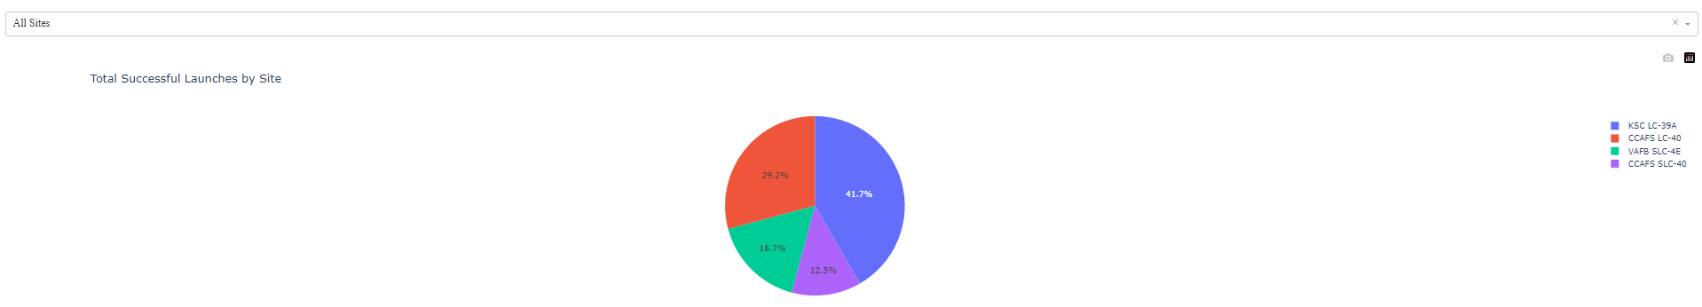
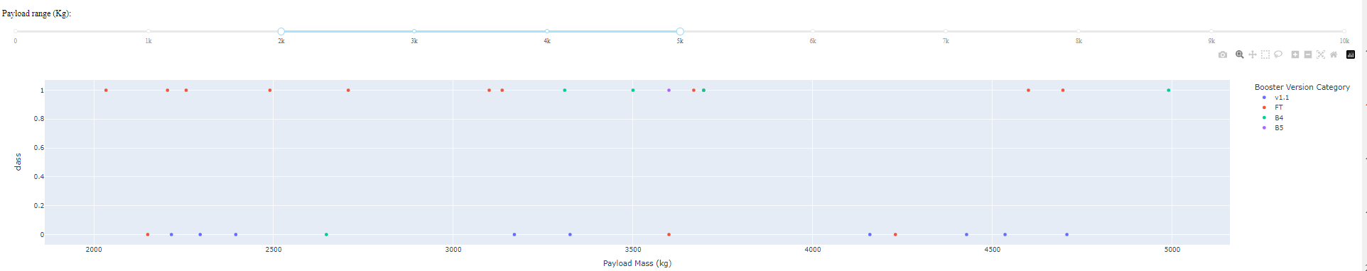
Dashboard Screenshots

Slide 18

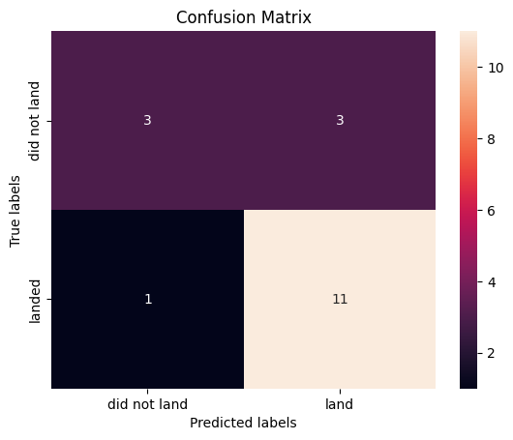
Results
SVM, KNN, LogReg
Decision Tree

Slide 19

Section 2

Slide 20
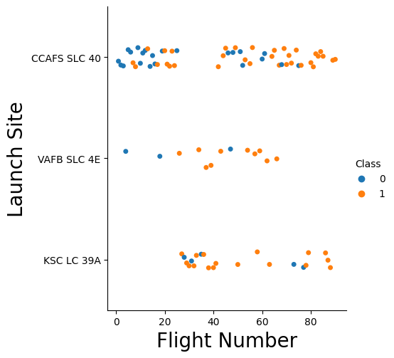
Flight Number vs. Launch Site
The scatterplot demonstrates that SLC 40 had more successful landings through its early iterations; other launch sites did not display any noticeable pattern

Slide 21
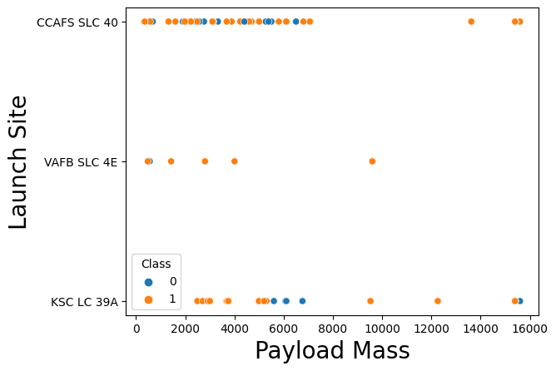
Payload vs. Launch Site
A general pattern of most launches having mass lower than 8000kg

Slide 22
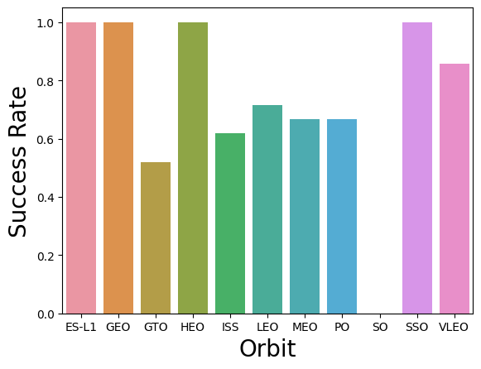
Success Rate vs. Orbit Type
Show a bar chart for the success rate of each orbit type
Show the screenshot of the scatter plot with explanations

Slide 23
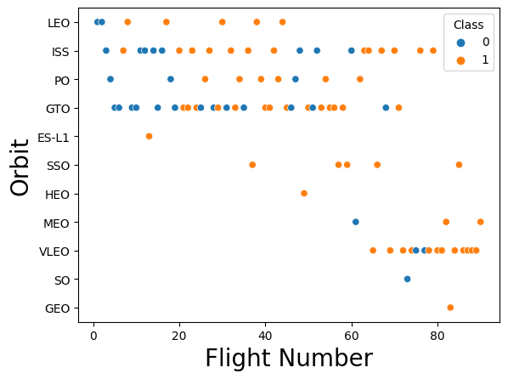
Flight Number vs. Orbit Type
Certain orbits have higher number of successful lands such as VLEO and ISS, while others have more failures such as GTO and ISS
Certain launches to specific orbits were only available in later launches, possibly contributing to its higher success rate

Slide 24
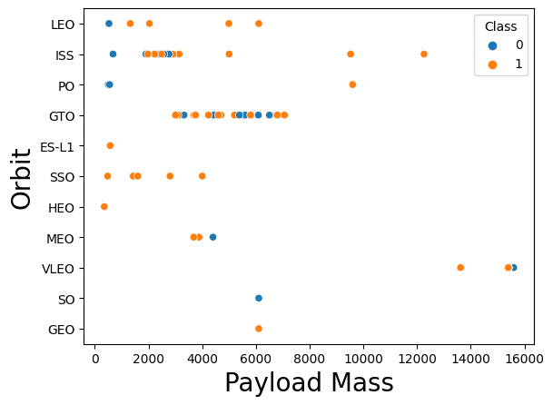
Payload vs. Orbit Type
Higher payload mass related to higher success rate except for the following orbits:
GTO
VLEO

Slide 25
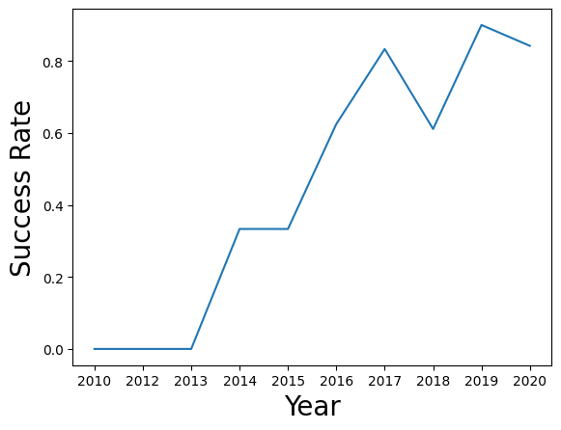
Launch Success Yearly Trend
It can be observed that as time went on, the success rate of landings tended to increase, showing signs of plateauing at around 80%

Slide 26
All Launch Site Names
Launch_Site
CCAFS LC-40
VAFB SLC-4E
KSC LC-39A
CCAFS SLC-40
There are 4 Launch Sites from the acquired data sets from which the rockets were launched

Slide 27
Launch Site Names Begin with 'CCA'
Launch_Ste
CCAFS LC-40
CCAFS LC-40
CCAFS LC-40
CCAFS LC-40
CCAFS LC-40
The following are 5 records from Launch Sites beginning with “CCA”

Slide 28
Launch Site Names Begin with 'CCA'
Date | Time (UTC) | Booster_Version | Launch_Site | Payload | PAYLOAD_MASS__KG_ | Orbit | Customer | Mission_Outcome | Landing _Outcome
04-06-2010 | 18:45:00 | F9 v1.0 B0003 | CCAFS LC-40 | Dragon Spacecraft Qualification Unit | 0 | LEO | SpaceX | Success | Failure (parachute)
08-12-2010 | 15:43:00 | F9 v1.0 B0004 | CCAFS LC-40 | Dragon demo flight C1, two CubeSats, barrel of Brouere cheese | 0 | LEO (ISS) | NASA (COTS) NRO | Success | Failure (parachute)
22-05-2012 | 07:44:00 | F9 v1.0 B0005 | CCAFS LC-40 | Dragon demo flight C2 | 525 | LEO (ISS) | NASA (COTS) | Success | No attempt
08-10-2012 | 00:35:00 | F9 v1.0 B0006 | CCAFS LC-40 | SpaceX CRS-1 | 500 | LEO (ISS) | NASA (CRS) | Success | No attempt
01-03-2013 | 15:10:00 | F9 v1.0 B0007 | CCAFS LC-40 | SpaceX CRS-2 | 677 | LEO (ISS) | NASA (CRS) | Success | No attempt
The following are 5 records from Launch Sites beginning with “CCA”

Slide 29
Total Payload Mass
The following query displays the total payload carried by boosters from NASA
SUM(PAYLOAD_MASS__KG_)
45596

Slide 30
Average Payload Mass by F9 v1.1
The following output is the average payload mass carried by booster version F9 v1.1
AVG(PAYLOAD_MASS__KG_)
2928.4

Slide 31
First Successful Ground Landing Date
The following is the date of the first successful landing outcome on ground pad
Date
22-12-2015

Slide 32
Successful Drone Ship Landing with Payload between 4000 and 6000
Booster_Version
F9 FT B1022
F9 FT B1026
F9 FT B1021.2
F9 FT B1031.2
The following table is the list of names of boosters which have successfully landed on drone ship and had payload mass greater than 4000 but less than 6000

Slide 33
Total Number of Successful and Failure Mission Outcomes
The query displays the total number of successful and failure mission outcomes
COUNT(DISTINCT("Landing _Outcome"))
11

Slide 34
Boosters Carried Maximum Payload
Booster_Version
F9 B5 B1048.4
F9 B5 B1049.4
F9 B5 B1051.3
F9 B5 B1056.4
F9 B5 B1048.5
F9 B5 B1051.4
F9 B5 B1049.5
F9 B5 B1060.2
F9 B5 B1058.3
F9 B5 B1051.6
F9 B5 B1060.3
F9 B5 B1049.7
The following are boosters which have carried the maximum payload mass

Slide 35
2015 Launch Records
The following table lists launches that had failed landing outcomes in drone ship, their booster versions, and their launch site names for the year 2015
Month | Landing _Outcome | Booster_Version | Launch_Site
January | Failure (drone ship) | F9 v1.1 B1012 | CCAFS LC-40
April | Failure (drone ship) | F9 v1.1 B1015 | CCAFS LC-40

Slide 36
Rank Landing Outcomes Between 2010-06-04 and 2017-03-20
Landing _Outcome | COUNT("Landing _Outcome")
Success | 20
Success (drone ship) | 8
Success (ground pad) | 6
Rank the count of landing outcomes (such as Failure (drone ship) or Success (ground pad)) between the date 2010-06-04 and 2017-03-20, in descending order
Present your query result with a short explanation here

Slide 37

Section 3

Slide 38
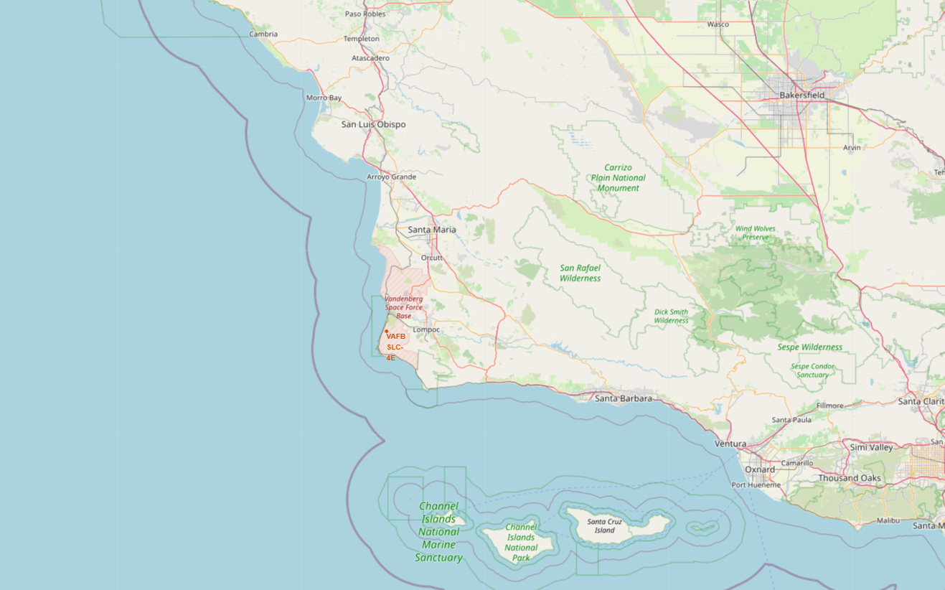
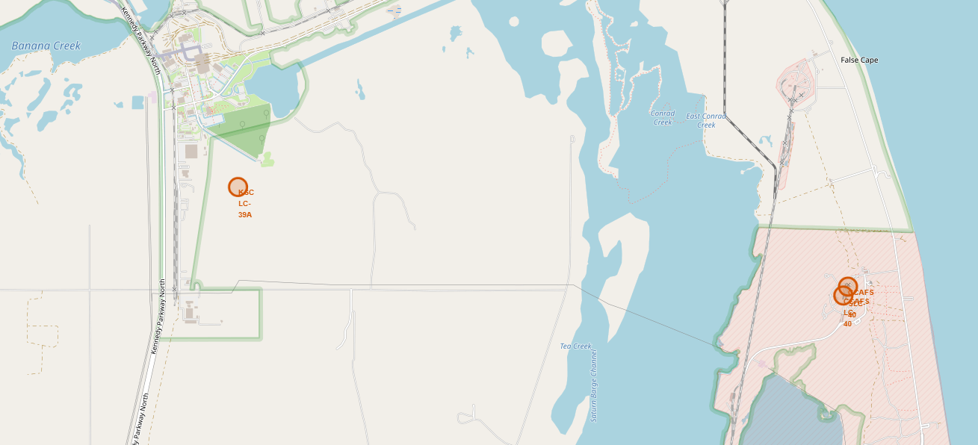
Launch Sites
The following screenshots have 4 circles which indicate the launch sites; 1 located on the west coast of the USA (California) and 3 located on the east coast of the USA (Florida)

Slide 39
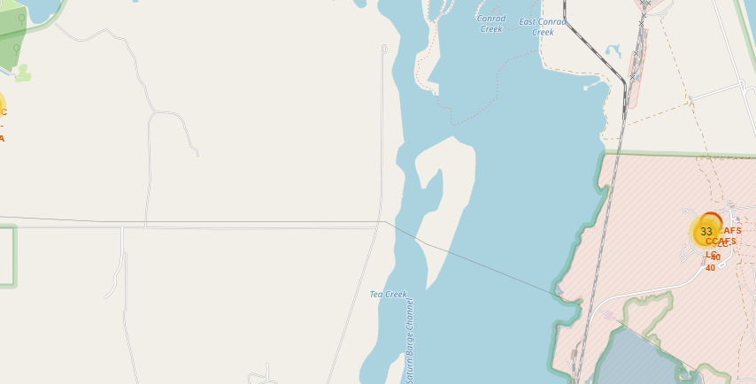
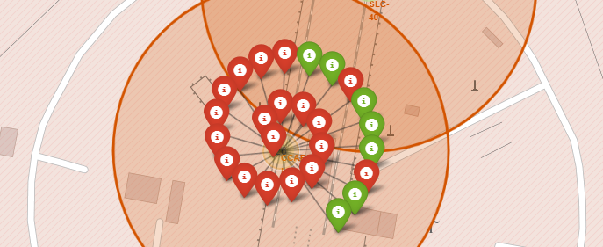
Launch Outcome based on Launch Site
The following screenshots shows a cluster which indicate the number of markers given a general area
The 2nd screenshot shows markers colored in red or green to indicate whether the landing of the first stage rocket was successful or not

Slide 40
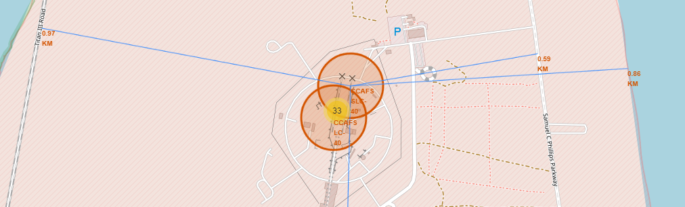
Major Geographical Elements’ Proximity to Launch Sites
The following map has blue lines pointing towards the nearest major coastline, roadway, rail, and city.
At the end of each line, there is the distance from the SLC-40 Launch Area

Slide 41

Section 4

Slide 42
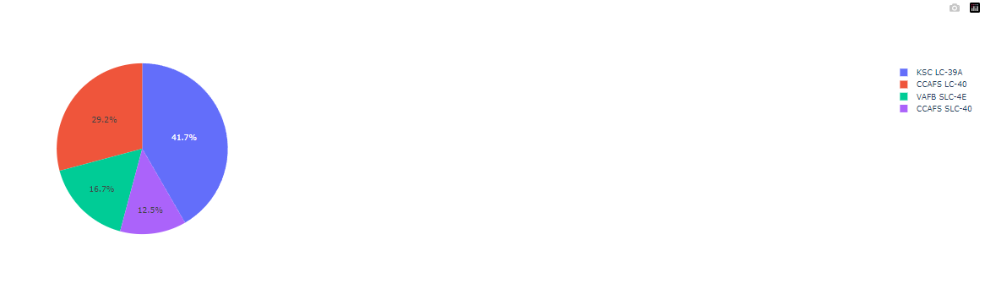
Total Successful Launches by Site
Out of all the successful landings, LC-39A had the most successes while SLC-40 had the least
However, this only counts which launch site had the most successful launches out of the total successful launches; not necessarily which one is most sucessful

Slide 43
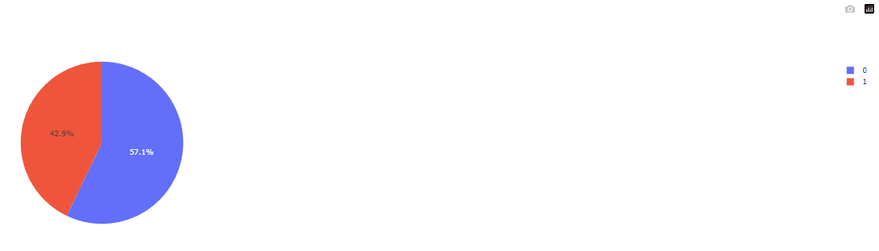
Highest Launch Success Ratio
CCAFS SLC-40 had the highest successful landing rate out of the 4 landing sites
Despite having the least number of successful launches, out of the launches that this launch site did have, around 43% resulted in a successful landing

Slide 44
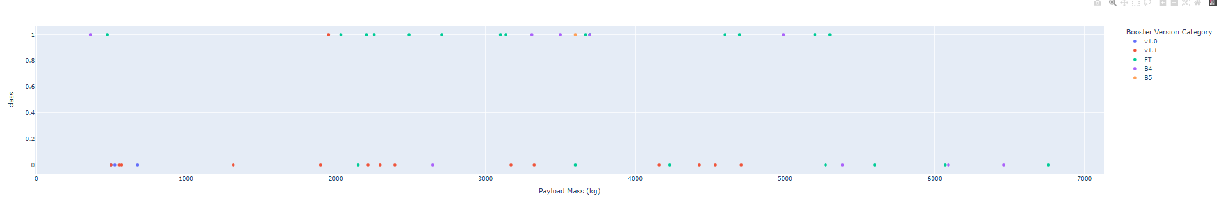
Payload and Booster Version to Success Rate
Explain the important elements and findings on the screenshot, such as which payload range or booster version have the largest success rate, etc.
FT and B4 Boosters were the boosters which experienced the most success when the payload is between a range of 2000kg and 5500kg
In general, those with a payload mass higher than 6000kg were unsuccessful
For those with a payload mass of less than 2000kg, it’s success depended on the booster version; FT and B4 being more sucessful

Slide 45

Section 5

Slide 46
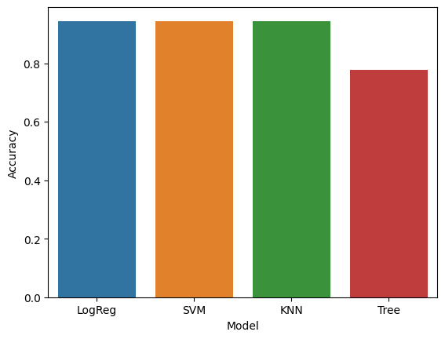
Classification Accuracy
Logistic Regression, Support Vector Machines, and K Nearest Neighbors had the highest accuracy of 94.44%

Slide 47
Confusion Matrix
The following Confusion Matrix is shared by the 3 models who had the highest accuracy
The model correctly predicted 100% of the time when the first stage rocket would land successfully, but would have issues of predicting those that did not land successfully as successful, albeit a low percent

Slide 48

Conclusions
From the analysis conducted on this scenario, the following conclusions should be particularly noted:
Payload Mass, Orbit Type, and Booster Versions were key elements in determining on whether the first stage rocket would land successfully
Another aspect to consider is that the more recent (such as future launches) will tend to have a higher success rate compared to launches with similar conditions during the first few launches by SpaceX
The 3 models selected, LogReg, SVM, and KNN, are able to determine whether launches would result in successful landing but with a slight problem with False Positives (predicting a successful landing when it will not). Regardless, all three models sport a 90% plus accuracy for out of sample data

Slide 49


